Slide 1


ENTSOG TYNDP
Kiev
30th October 2018
Ten Year Development Plan
Regulatory Workshop in the context of Infrastructure assessment and Projects of Eastern Partnership Interest
Stefano Astorri
ENTSOG Investment Subject Manager

Slide 2
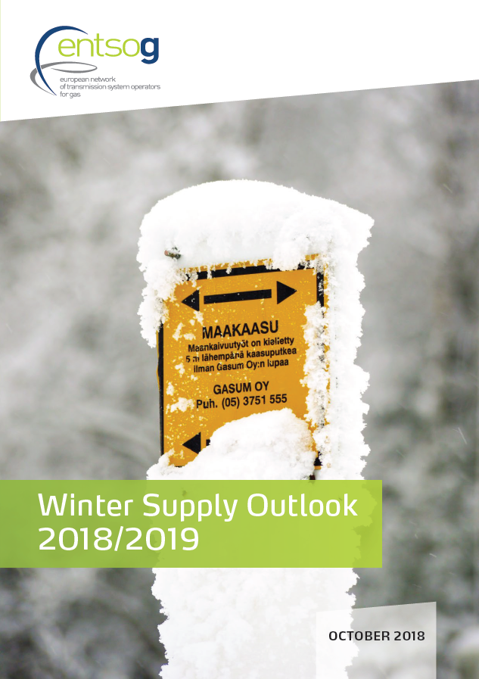
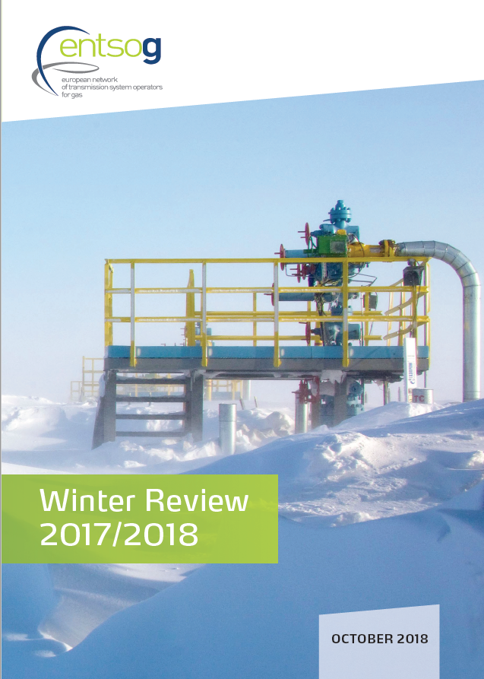
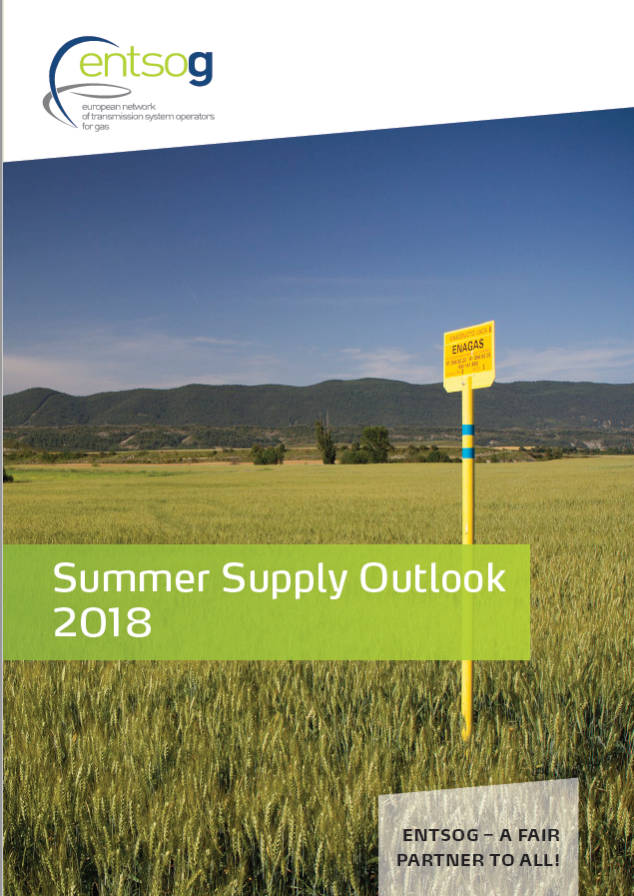
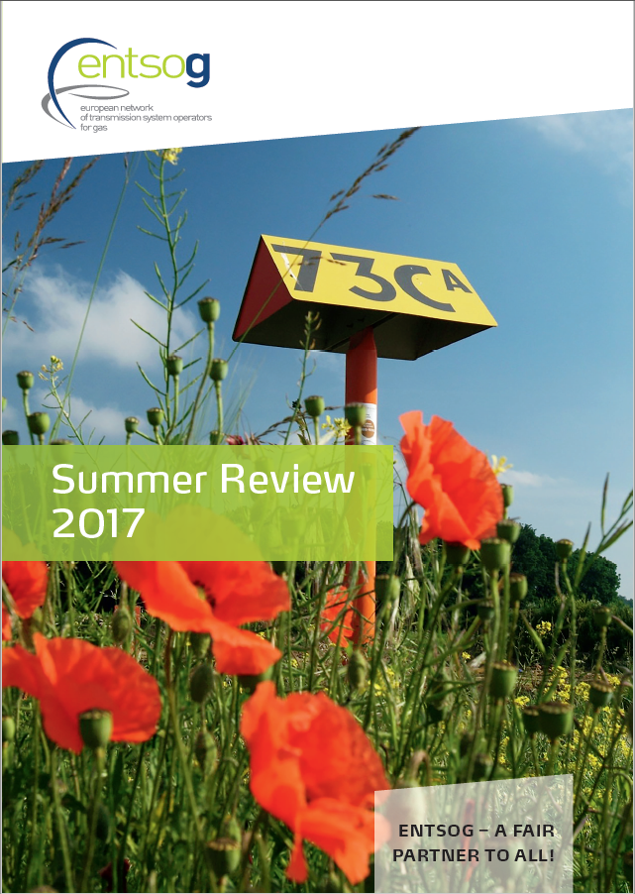
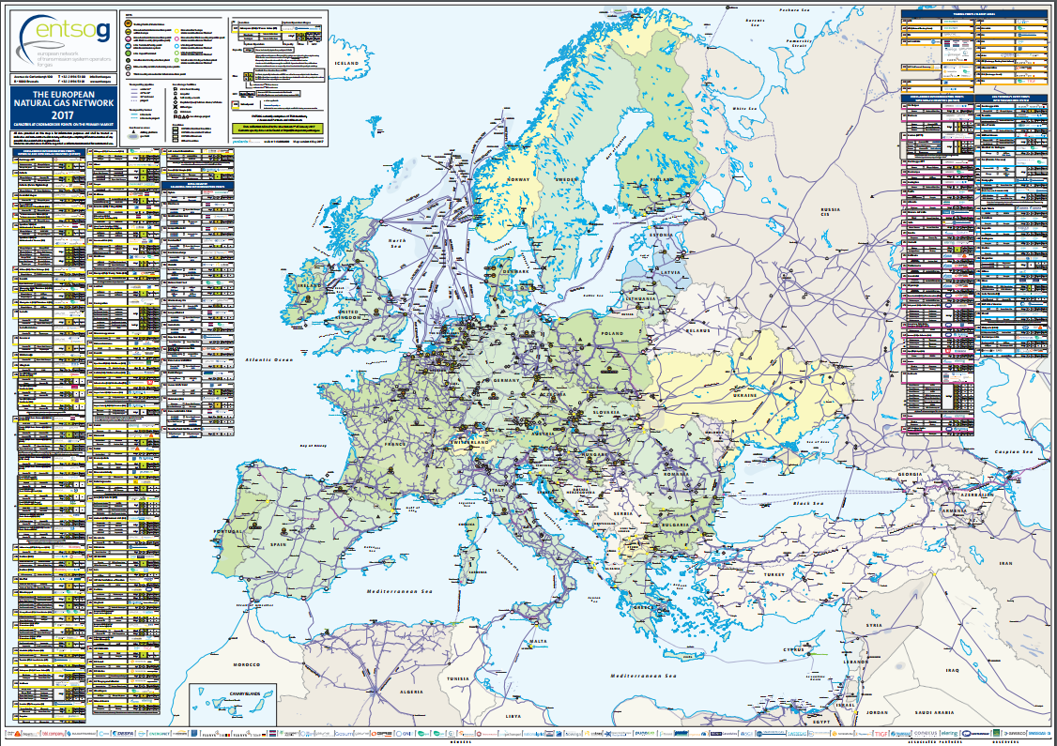

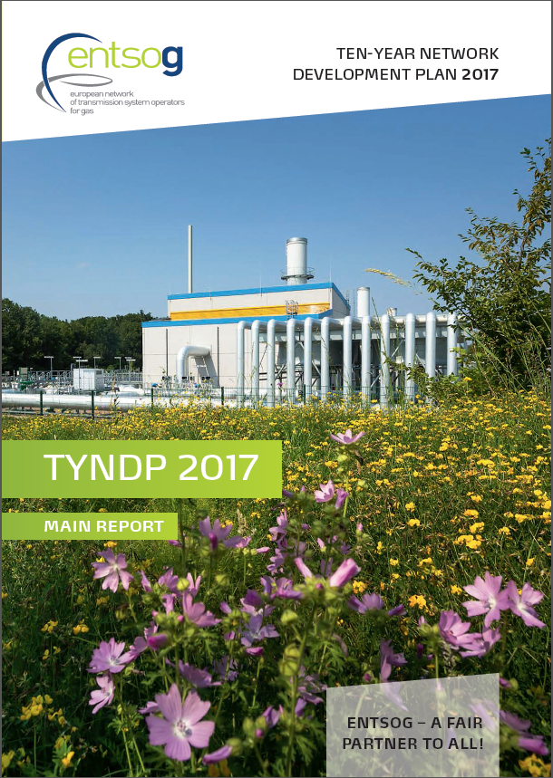
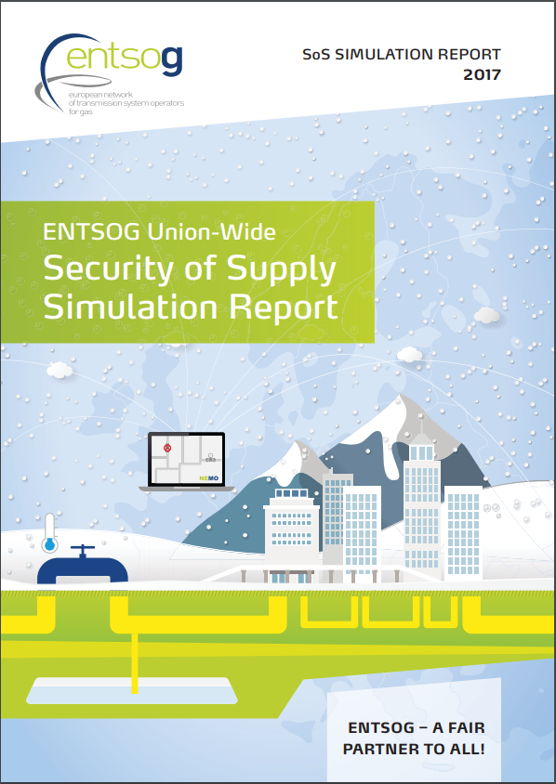
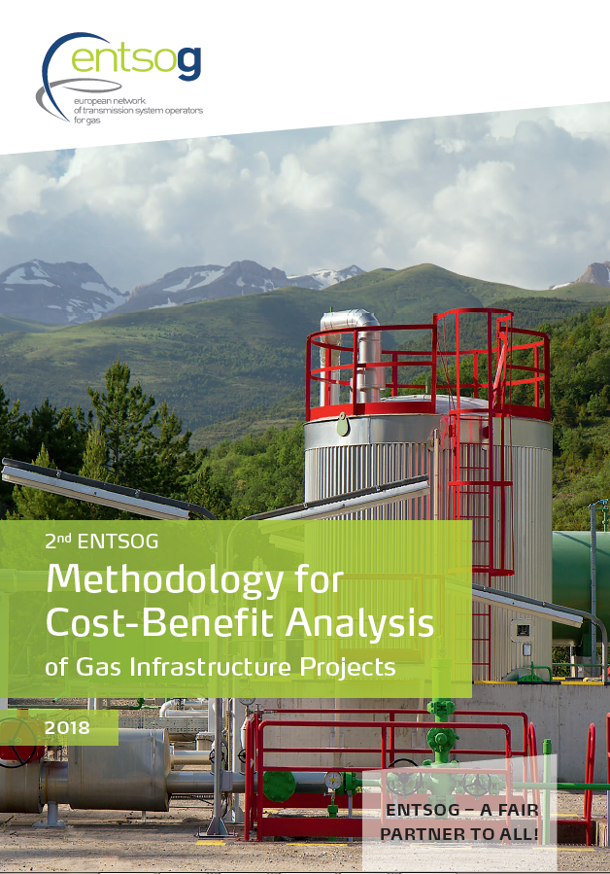
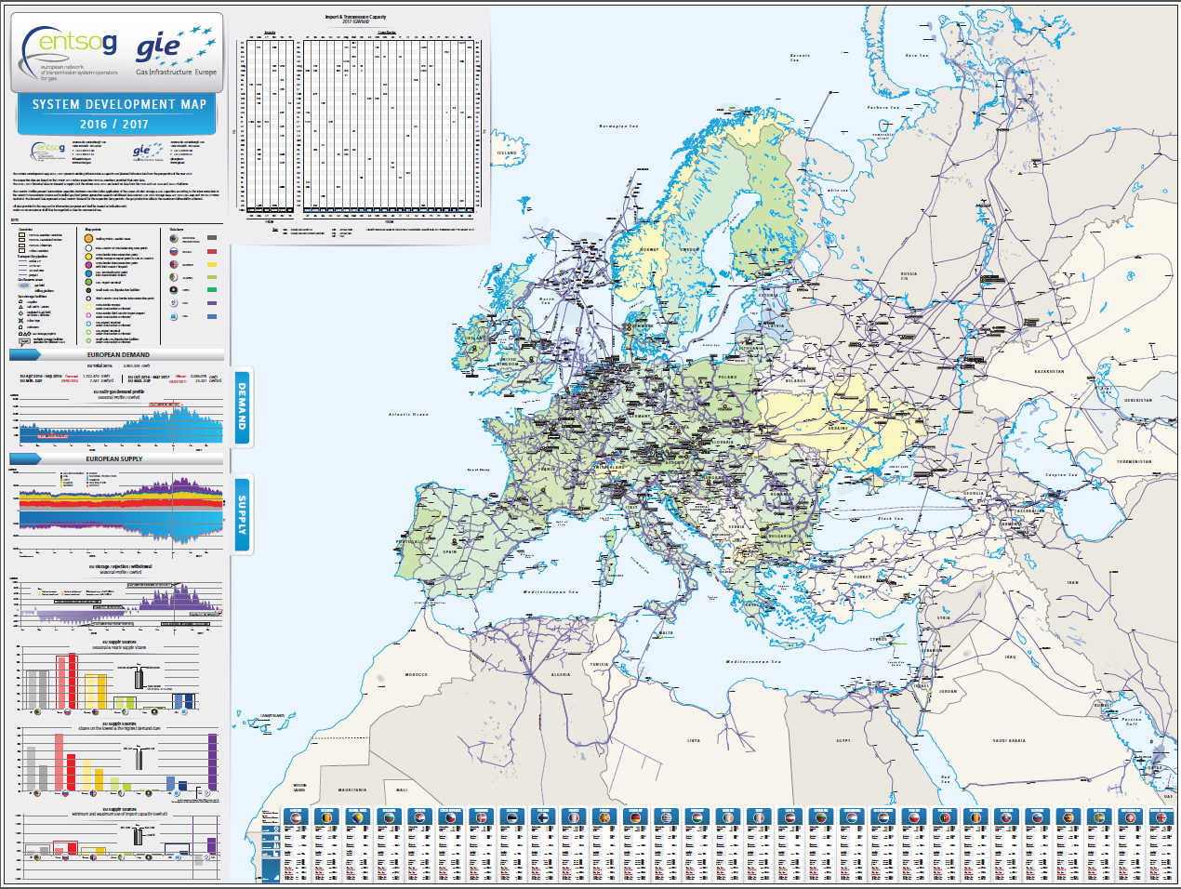
Publications by ENTSOG System Development
Click on the photos to access the Reports

Slide 3
Gas TYNDP 2018 main steps timeline
(*) for PCI applicants
End May-18: publication of TYNDP projects
and PS-CBA groups
Mid-Dec-18: publication identification of gaps
End Jan-19: publication PS-CBA fiches
End Jun-19: publication of Final TYNDP
Mar’16
Dec’16
Dec’17
Jul’18
Sep’18
Dec’18
Jun’18
Gas and Elect. ENTSOs Scenario Development
Adapted CBAM (Oct)
CBAM EC approval (Mid-Nov)
Gas CBA Methodology 2.0
Inclusion of projects in TYNDP
System & needs
assessment
Projects assessment (*)
Public workshop, webinar, SJWS or Prime Mover WS
Consultation with the member states
Draft TYNDP Report
Final TYNDP
Report
Public consultation
Submission of projects in TYNDP
ACER Opinion (2 months)
ENTSOG TYNDP 2018 will support European Commission 4th PCI process

Slide 4
TYNDP 2018 Scenario Building Process
Dec ’16
Dec ’17
Gas and electricity ENTSOs Scenario Building
25/04/2016
12/06/2016
02/10/2017
10/11/2017
30/03/2018
Public Web
Consultation
Public Web
Consultation
Public Web
Consultation
Draft scenario storylines
Work
shop
Work
shop
Scenario storylines
Work
shop
Data collection
Scenario building process
Draft
Scen. Report
Work
shop
Final
Scen. Report
02/06/2016
05/07/2016
10/10/2016
09/10/2017
Workshop
A 2-year process with thorough stakeholder engagement

Slide 5
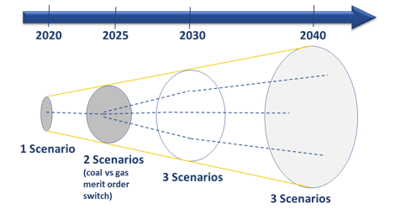
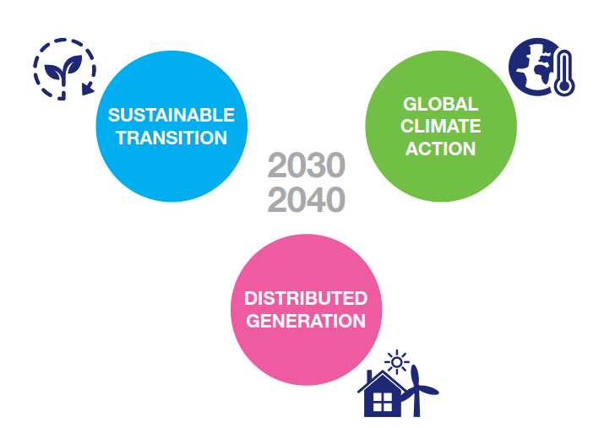
Scenario Framework
3 markedly different scenarios capturing the possible future paths
with a common goal: EU 2030 and 2050 energy and climate targets
Commission core 2030 policy scenario
EUCO30
Maximising the use of existing infrastructure
Large scale renewables development in both electricity and gas sectors
Prosumer driving climate change
Notes:
Joint development approach results in a set of ambitious, technically robust and equally realistic scenarios.
The scenarios outline three markedly different possible paths towards a low-carbon energy system in line with EU targets.
They build on innovative and challenging storylines and are complemented by an additional perspective based on the EC EUCO 30 policy scenario

Slide 6
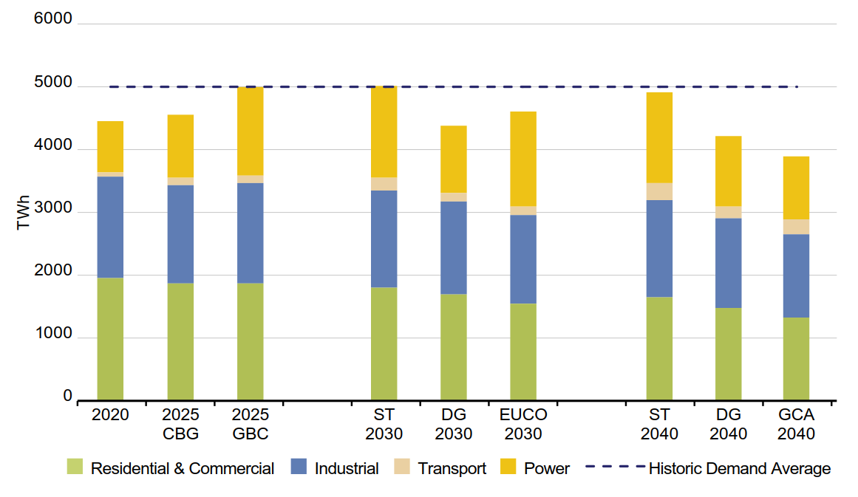
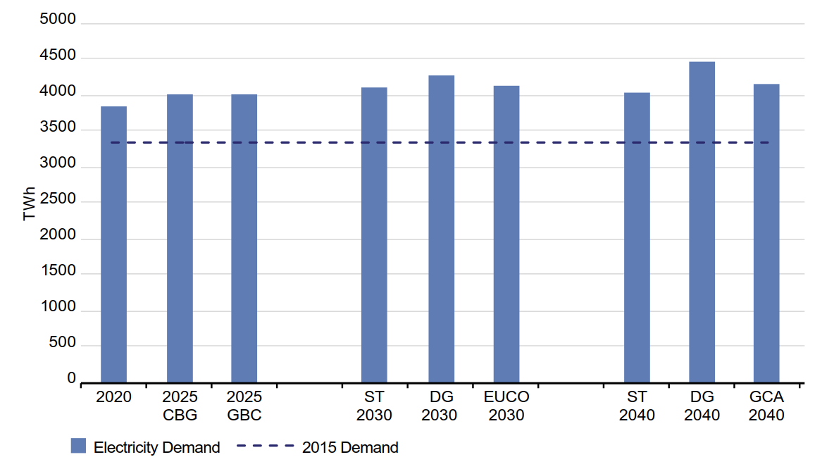
Energy Demand
Electricity annual demand
Gas annual demand
Coordinated approach on heating and transport sectors
Gas to power stems from
modelling power generation mix
Coordinated approach on heating and transport sectors
Decarbonisation and energy efficiency reshape energy demand.
Gas has a role in all demand sectors.

Slide 7
Joint ENTSOs Scenario Development
Ensuring the consistent assessment of the two key energy networks of Europe against the same futures
  The ENTSOs joint scenario building process for TYNDP 2020 has started, after it was applied for the first time for TYNDP 2018.
  Scenarios cover all energy use, in Transport, Heating and Industry, and address the role of the energy carriers gas and electricity.
  Carbon emissions and RES integration are key features in the scenario development.
TYNDP 2020 scenario development has started
Carbon emissions and level of de-/centralisation are key features
Notes:
In December 2016 the ENTSOs submitted their “ENTSOs draft consistent and interlinked electricity and gas model” (the draft Interlinked Model), based on TEN-E Regulation and interactions with EC and ACER

Slide 8
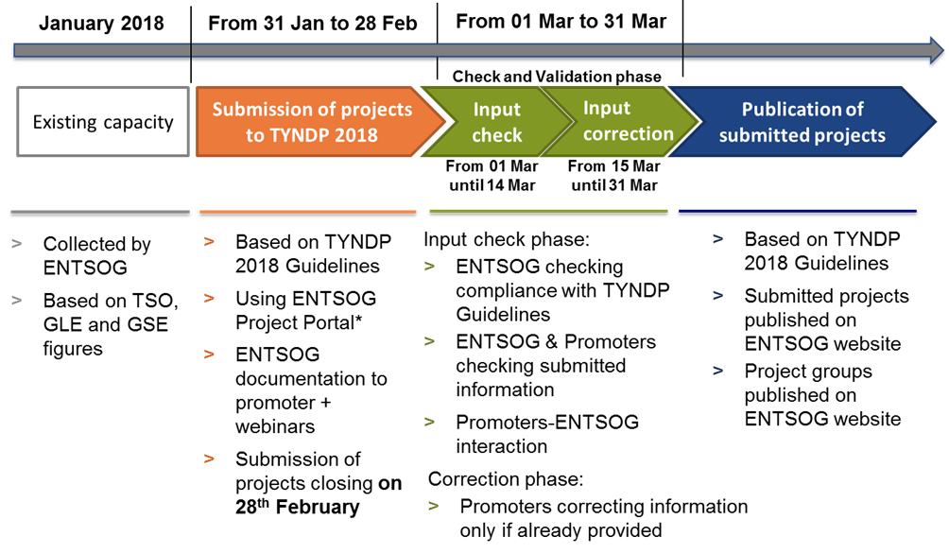
TYNDP 2018 Project Collection process

Slide 9
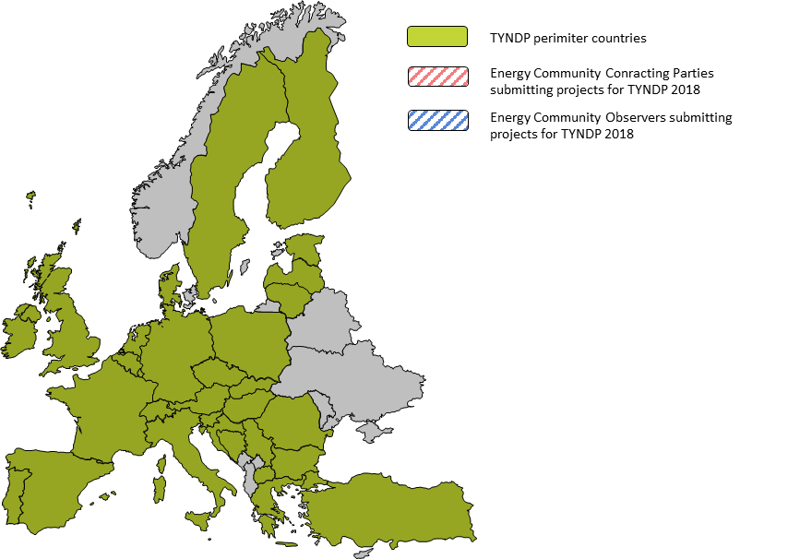
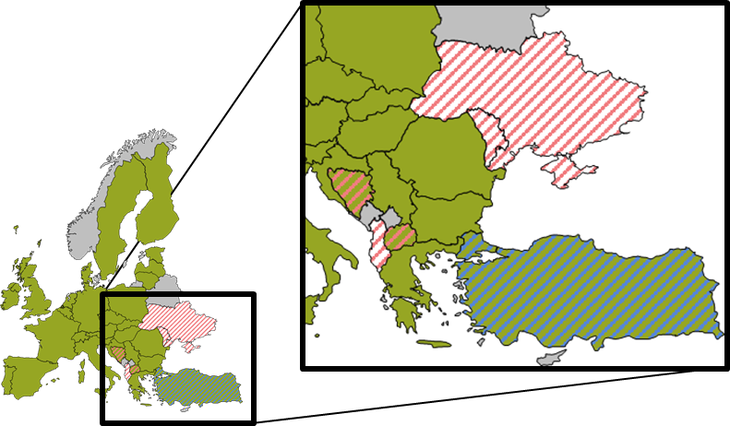
ENTSOG TYNDP project perimeter
  207 investment submitted for TYNDP 2018 (link)
  Concerning 37 countries
  Of which 10 countries not being part of EU

Slide 10
CBA methodology: guidelines for TYNDP assessments
TYNDP is a regulatory task for ENTSOG
  Reg. (EU) 715/2009: deliver a supply adequacy outlook and identify possible investment gaps
  Reg. (EU) 347/2013: gather all possible PCI candidates, apply CBA methodology to TYNDP
System assessment
Scenario
Projects
Existing infrastructure
external data
PCI process
CBCA
&
CEF
PCI candidates –Project CBAs
CBA methodology setting the frame
New for TYNDP 2018
Notes:
Cba is receipe, TYNDP the pan and we need ingrdients!

Slide 11
2nd ENTSOG CBA Methodology
ENTSOG has released its Adapted CBA Methodology for European Commission approval
  Main improvements:
    more streamlined methodology
    increased transparency
    refined market modelling assumptions
    indicators simplification
    project grouping guidelines
    improved sensitivity analysis

Slide 12
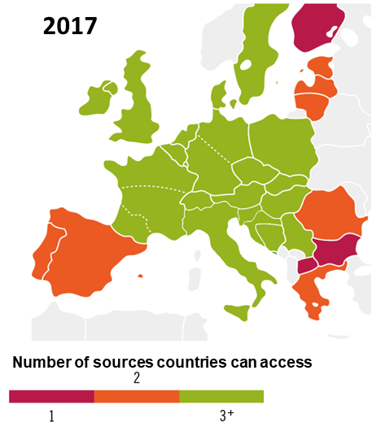
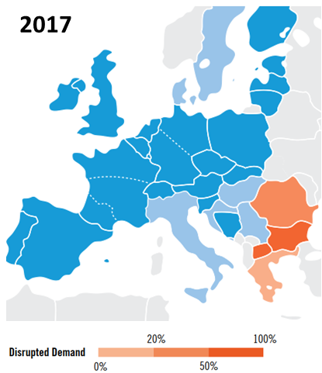
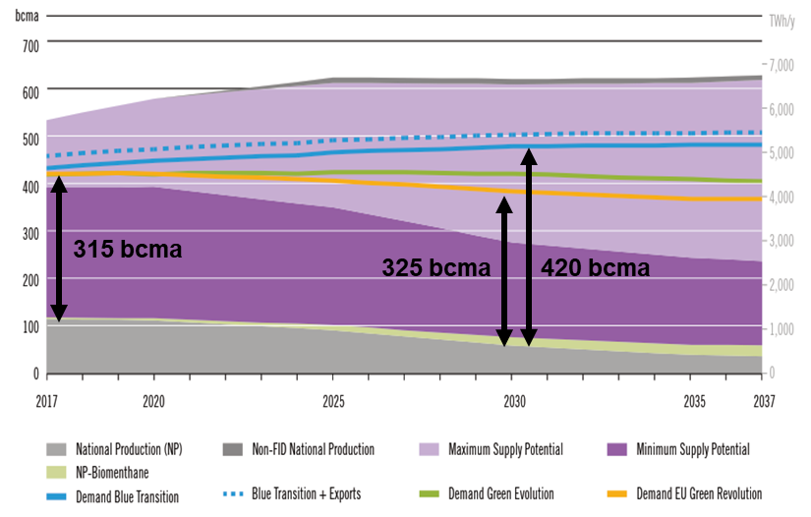
What do we use TYNDP and CBAM for?
1. Assess the gas system: what are the remaining infrastructure needs?
2. Assess projects: how do projects address the infrastructure needs?
Access to new supply sources: diversification and competition
Supply diversification
Security of supply
example from TYNDP 2017
example from TYNDP 2017
example from TYNDP 2017
CBA Methodology as common metrics to system and project assessment
Notes:
Project assessment to be always complemented by promoters

Slide 13
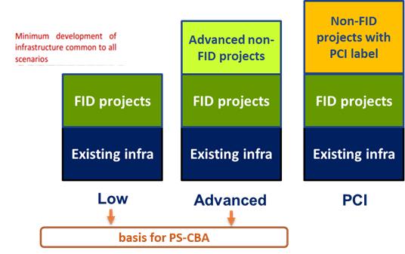
System assessment
  LOW infrastructure level to identify any infrastructure gasp in Europe
  Advanced infrastructure level to take into account further project interaction
  PCI infrastructure level to see how the current PCI List mitigates/solves the identified infrastructure gaps

Slide 14
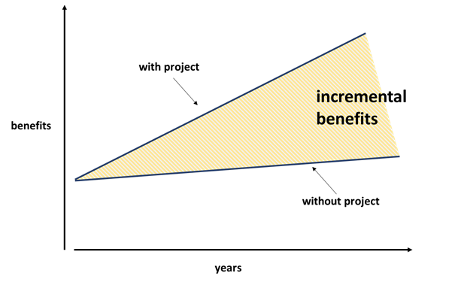
Project-specific assessment (PS-CBA)
  Project-specific assessment is carried with/without each project (or project group) for both infra levels
  It measures the incremental impact in mitigating the identified infrastructure needs

Slide 15
Socio-Economic benefit analysis
ENTSOG CBA Methodology combines monetary elements from the CBA approach as well as non monetary and/or qualitative elements referring to the Multi-Criteria Analysis (MCA)
  Gas infrastructure projects potential benefits:
  Reduction of the cost of gas supply (change in the Social Economic Welfare)
  Contribution to security of supply
  Price convergence
  Fuel replacement
    Substitution of more expensive fuels
    Reduction in CO2 emissions
  Increase of the number of supply sources
  Decrease in country supply dependency
All the benefits are measured as the incremental project impact

Slide 16
ENTSOG/ENTSO-E Interlinked Model Focus Study
Assessing electricity and gas interactions

Slide 17
ENTSOs Focus Study
Study scope and tasks
  Main goal: conceptually assess which electricity/gas interactions are relevant from a TYNDP perspective, including potential interactions between projects
  The study outcome will be used by ENTSOs to further adapt the Interlinked Model - which will form part of the CBA Methodology - and the ENTSOs will apply it to relevant projects.
  Study tasks
    1. Generic mapping of all potential electricity/gas interactions
    2. Qualitative analysis of potential elec/gas infrastructure interactions
    3. Quantification of infrastructure interaction parameters
    4. Propose recommendations on screening approach to identify projects to be retained for gas/electricity interaction assessment
ENTSOs will build on the study outcome to adapt their Interlinked Model
and apply to relevant projects for the next TYNDPs

Slide 18
Stefano Astorri
Investment Subject Manager
Stefano.Astorri@entsog.eu

