Slide 1

Webinar series: Integrated national energy and climate progress reports
#2 Energy efficiency policies and measures
—
    Niklas Reinfandt – 03.11.2025

Slide 2



Introduction of the governance/institutional setup for NECPR
Capacity needs, involved experts, and tools used
NECPR process coordinated by a unit within the Federal Ministry for Economic Affairs and Energy of Germany (BMWE):
            Collecting relevant information from the respective responsible bodies (clearly assigned responsibilities for each Annex and/or table):
              Specialist departments and units for the different topics within the BMWE
              Specialist departments and units for the different topics within other ministries (e.g. Federal Ministry for Environment, Nature Conservation and Nuclear Safety, Federal Ministry of Finance, Federal Ministry for Housing, Urban Development and Building)
              Other subordinated federal authorities (e.g. Federal Environment Agency; relevant for energy efficiency: Federal Energy Efficiency Center within the Federal Office for Economic Affairs and Export Control)
The process is currently being supported by an accompanying project:
            Support for the data collection, plausibility checks and formatting for the subsequent submission:
              Consortium of 3-4 experienced institutes (experience with the NECP, measure evaluations and monitoring, data plausibility checks in the field of energy and climate policy, modelling of measures (e.g. projection report))
                Prognos, Öko-Institut, Fraunhofer ISI
              ca. 6 experts involved in the project
Additional support for specific inputs in various projects (evaluations, projection report, ...)

Slide 3
Annex IX: Progress accomplished towards implementing the national policies and measure – Table 1, 3, 5
One of the more complicated annexes, a lot of different information needed and a lot of overlapps with other annexes (especially PAM IDs)
1
Key characteristics and progress towards implementing policies and measures
important first step: defining the PAMs IDs (also needed for other annexes and tables)
mostly general information on the measures
most complicated part maybe Field 18-21 including indicators and progress (dependent on the availability of specific data)
Important sources: NECP, legal implementation of measures (legal text, funding guidelines, etc.), implementing and/or responsible authorities, evaluations and expert reports
3
Available results of ex-ante and ex-post assessments of the effects of individual or groups of policies and measures on energy efficiency (voluntary)
data can be partly taken from Annex 10 and Annex 11
Important sources: NECP, evaluations and expert reports, impact assessments and modelling approaches (e.g. projection report), MURE database and methodologies
5
Available projected and realised costs and benefits of individual or groups of policies and measures on energy efficiency (voluntary)
Important sources: NECP, legal implementation of measures (legal text, funding guidelines, etc.), implementing and/or responsible authorities, Financial budgets of the government and implementing authorities
Helpful source field 1d (Benefits in EUR per toe final energy consumption reduction): MICATool

Slide 4
Annex IX: Progress accomplished towards implementing the national policies and measure – Table 1, 3, 5
Our approach:
Remark: potentially strong synergies with MURE
1
Preparation
assigning responsibilities (tables -> specific measures) - ministry
preparing one “comprehensive” Excel template, including all annex IX info/fields - experts
providing some basic guidance in the template (e.g. mandatory vs voluntary etc.) - experts
2
Collecting information
per table or measure – ministries and authorities
providing expertise and support where needed - experts
Checking the collected information (complete and plausible?) - experts
3
4
If needed: second round of data/information collection
5
Submission
Preparation of the data and tables - experts
Submission – ministry

Slide 5
Annex X: Energy efficiency obligation schemes and alternative measures
New measures EED – table 1-4
Notification of new measures (not previously notified in NECP etc.)
General helpful source:
Guidance documents by the EU
1
Energy efficiency Obligation Schemes (EEOS) referred to in Article 7a of Directive 2012/27/EU
n.a. in Germany
Important sources: NECP, legal implementation of EOS (legal text, funding guidelines, etc.), implementing and/or responsible authorities, evaluations and expert reports
2
Alternative policy measures referred to in Article 7b and Article 20(6) of Directive 2012/27/EU)
in Germany: Federal Energy Efficiency Center as responsible authority, supported by a project/ expert consortium (especially support for monitoring and ex-ante assessments)
Important sources: NECP, legal implementation (legal text, funding guidelines, etc.), implementing and/or responsible authorities, evaluations and expert reports
3
Information on taxation measures
Important: calculation methodology and used elasticities
Important sources: NECP, legal implementation (legal text, funding guidelines, etc.), implementing and/or responsible authorities, evaluations and expert reports
4
Information about the lifetime of the individual actions eligible to the policies and measures reported
Important sources: evaluations and expert reports, MURE-database

Slide 6
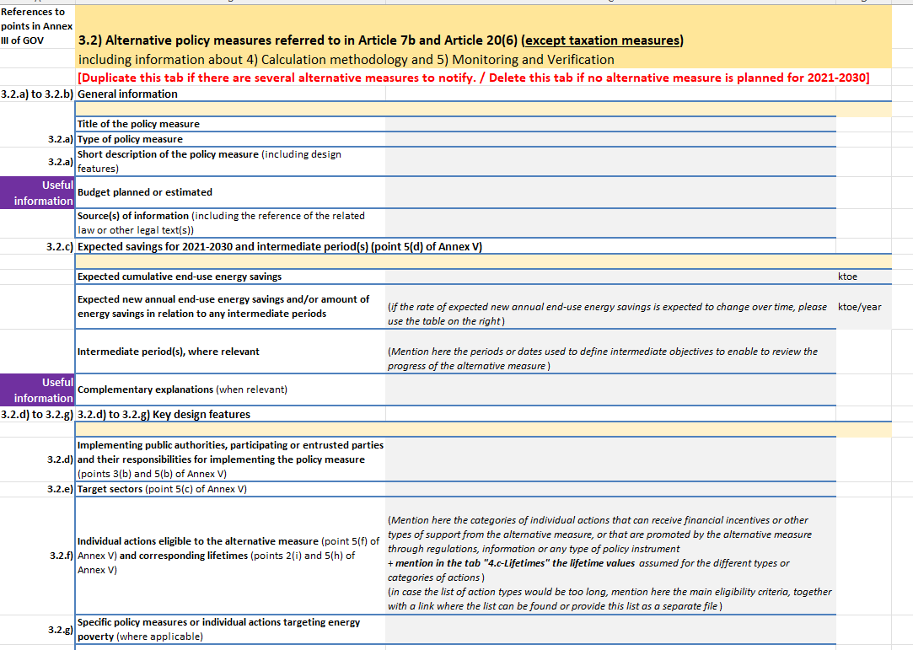
Annex X: Energy efficiency obligation schemes and alternative measures
Template for the notification of new measures – alternative measures

Slide 7
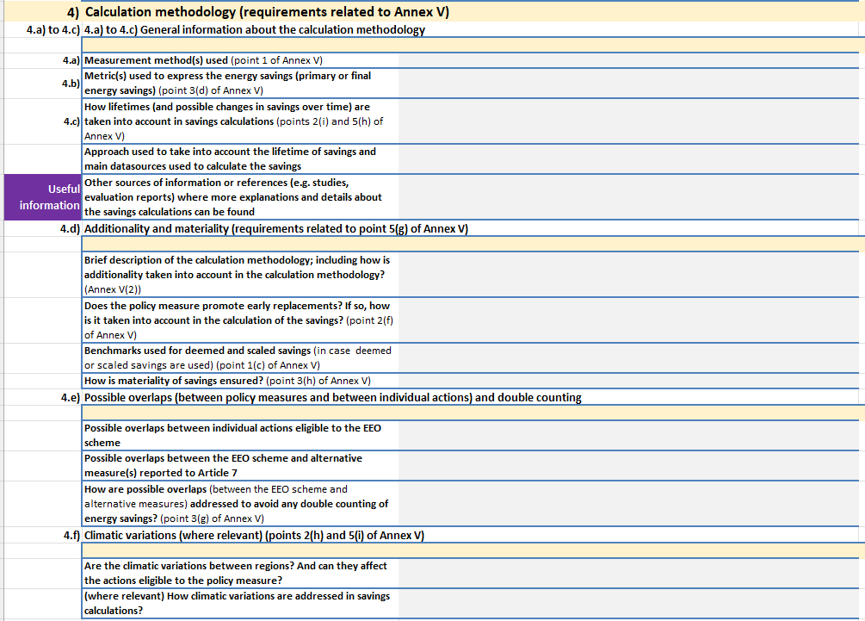
Annex X: Energy efficiency obligation schemes and alternative measures
Template for the notification of new measures – alternative measures

Slide 8
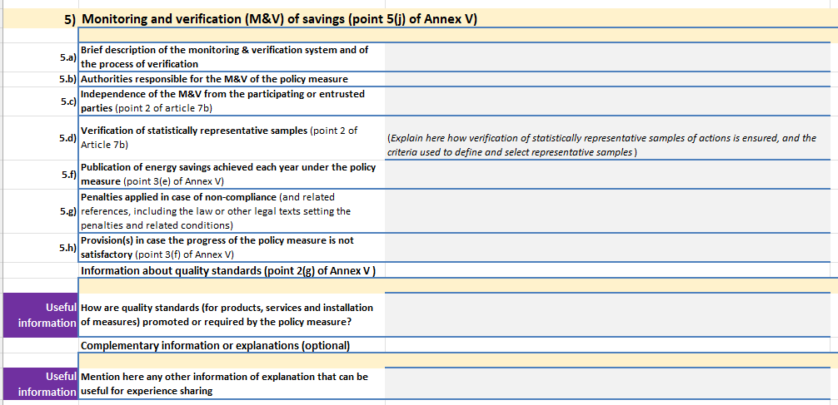
Annex X: Energy efficiency obligation schemes and alternative measures
Template for the notification of new measures – alternative measures

Slide 9
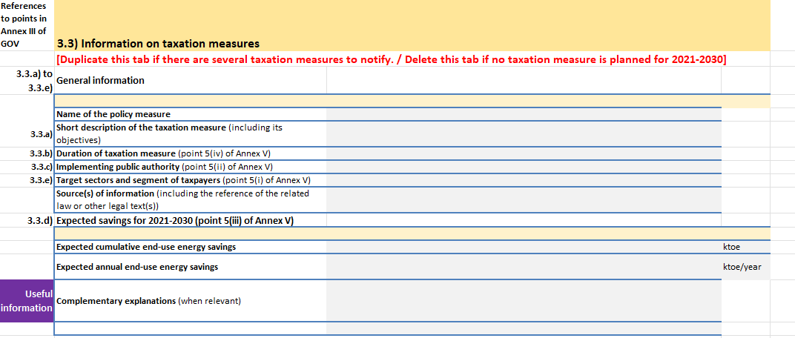
Annex X: Energy efficiency obligation schemes and alternative measures
Template for the notification of new measures – taxation measures

Slide 10
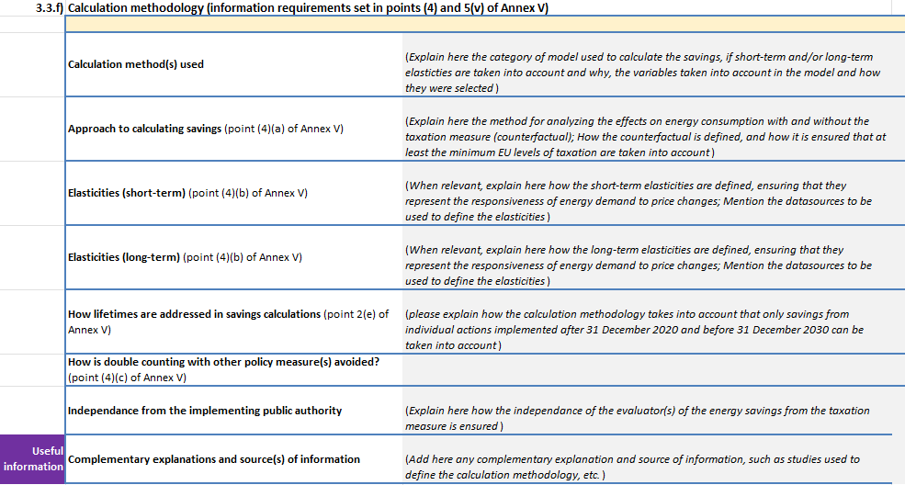
Annex X: Energy efficiency obligation schemes and alternative measures
Template for the notification of new measures – taxation measures

Slide 11
Annex XI: Information on the energy savings achieved
For the years X-2 and X-3
Reporting on achieved savings through notified measures
General helpful source:
Guidance documents by the EU
1,2
Energy savings for X-2 and X-3
based on the national monitoring of energy efficiency measures
  savings may need some adjustments for EU reporting (additionality towards EU law)
Important sources: implementing and/or responsible authorities, evaluations and expert reports, measure specific data (e.g. funding decisions), monitoring authorities
In Germany: Federal Energy Efficiency Center (BfEE) as responsible authority, supported by a project/ expert consortium (especially support for monitoring and ex-ante assessments)
  High number of different measures (ca. 40)
  Continous process with many involved bodies
  Important: regular and timely evaluations for all important measures, requires a lot of expert knowledge
Usefull general information on the calculation of energy savings is also provided by the Streamsave and Streamsave+ project

Slide 12
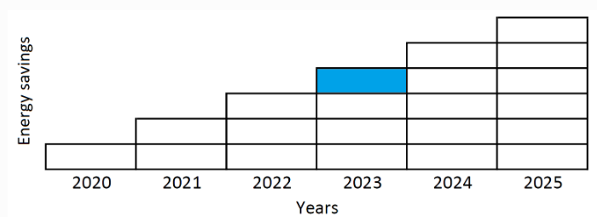
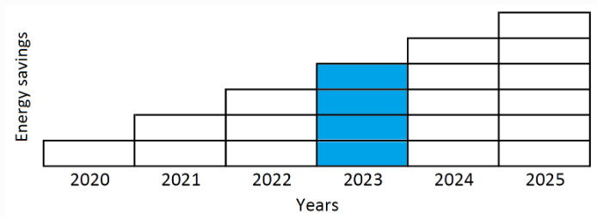
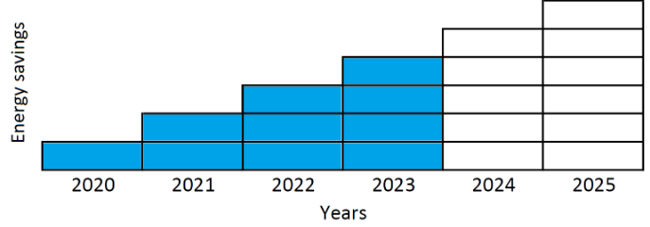
Annex XI: Information on the energy savings achieved
Side note – energy saving metrics and lifetimes
New annual savings
Total annual savings
Cumulative savings

Slide 13
Annex XI: Information on the energy savings achieved
Montoring
Our approach:
(yearly cycle for the national monitoring of energy efficiency measures)
1
Preparation of the data collection
assigning responsibilities in the ministries for each measure – BfEE, ministries
preparation of the monitoring templates (Excel or online database)
based on the notification template, streamlined with with national and EU reporting needs - experts
providing some basic guidance in the template (e.g. mandatory vs voluntary etc.) - experts
2
Collecting information
per table or measure – ministries and authorities
providing expertise and support where needed – experts
Checking the collected information and data (complete and plausible?) - experts
3
4
If needed: second round of data/information collection
5
Submission
Preparation of the data as well as required analyses - experts
Submission – ministry

Slide 14
Annex XI: Information on the energy savings achieved
Monitoring – important information
General information
responsible body
description of the measure, beginning and end of the measure
type of measure, adressed sector and energy carrier
legal basis
reporting obligations
source of financing
Energy savings for the year X (gross savings)
savings by energy carrier
financial indicators
average lifetime of the improvement actions
activity indicators (e.g. number of funding decisions)
type of saving calcution and detailed calculation methodology
Info on latest evaluation
Correction factors (net savings)
„Internal“ correction factor based on:
e.g. spillover effects, free-rider effects, rebound effects
Correction factor for determining cross-measure correction (interaction effects/interdependencies)
Further information
measure adressing energy poverty?
distributional effects
helpfull source for more details on the correction factors

Slide 15
Thank you for your attention!
  —
Contact
  —
    Dr. Niklas Reinfandt
    Coordinator of the business unit Energy Policy
    Niklas.Reinfandt@isi.fraunhofer.de
      Fraunhofer-Institut für System- und Innovationsforschung ISI
      Breslauer Straße 48
      76139 Karlsruhe
      www.isi.fraunhofer.de

