Slide 1

Webinar series: Integrated national energy and climate progress reports
Synergies between ODYSSEE-MURE and NECPRs
—
    Wolfgang EICHHAMMER, Fraunhofer ISI / IEECP / Utrecht University – 03.11.2025

Slide 2
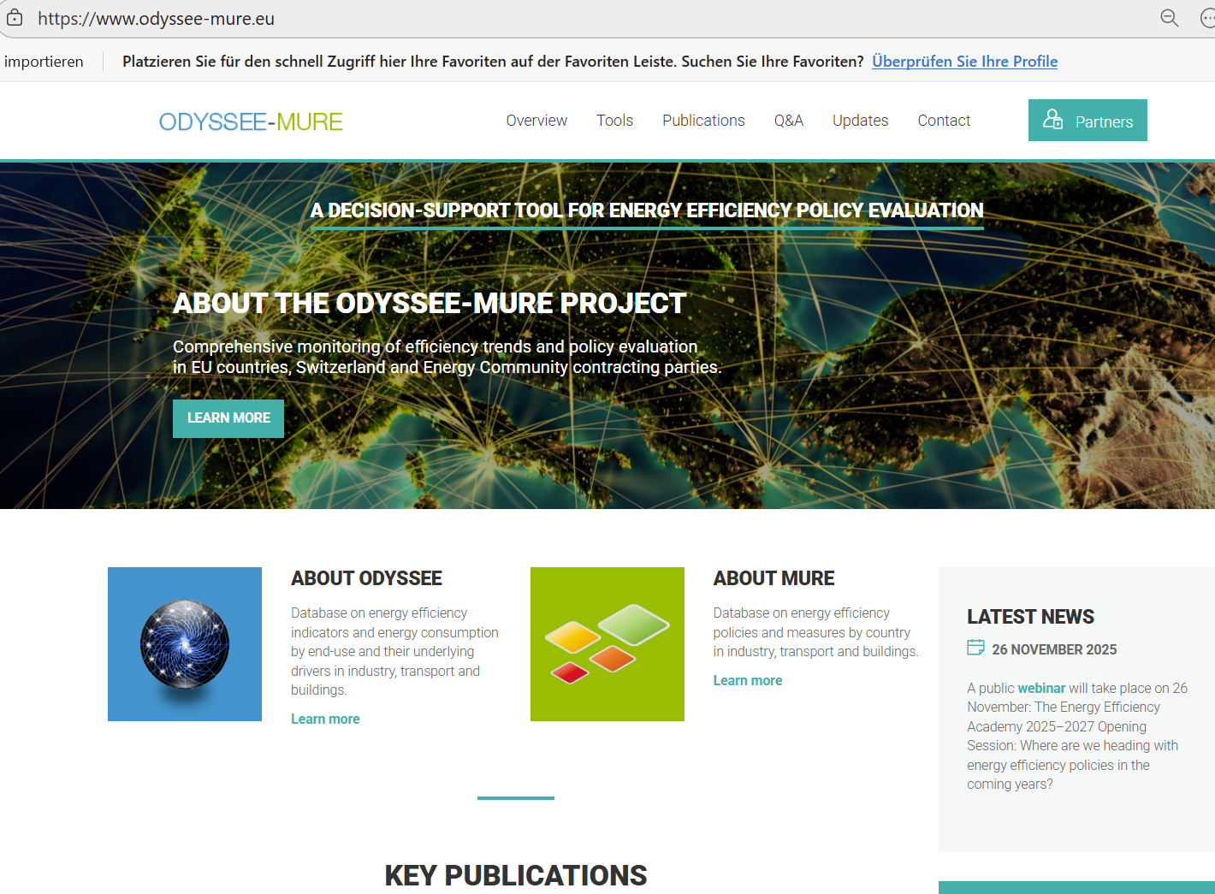
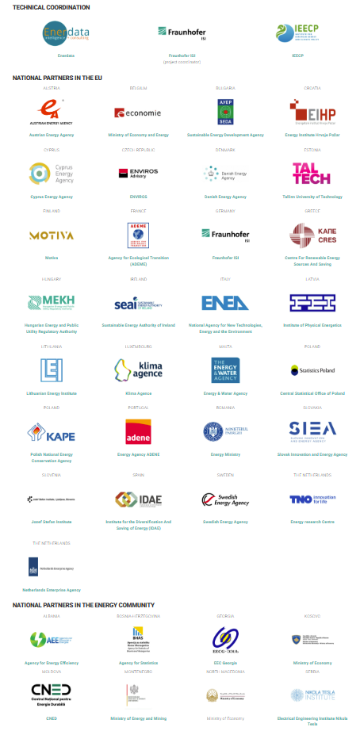

ODYSSEE-MURE project
Quick Overview

Slide 3
ODYSSEE-MURE project
Overview
Project objectives
​The 2025-2027 period of the project, ODYSSEE-MURE is focused on supporting the national implementation and monitoring of key provisions of the Energy Efficiency Directive recast (EED, (EU)2023/1791).
Odyssee and Mure databases: ODYSSEE-MURE - Monitoring the EED-Recast, supported by the LIFE programme of the European Commission, relies on 2 complementary databases:
ODYSSEE contains detailed energy efficiency and CO₂ indicators with data on energy consumption, their drivers (e.g. activity indicators) and related CO₂ emissions.
MURE provides quantitative, semi-quantitative and qualitative information on energy efficiency policies implemented at EU or national level.
​Tools and Analyses
Decomposition Tool / Policy Assessment Tool (policy gaps) / Energy Efficiency Scoreboard / Energy Savings Tool / Link to Multiple Benefits Tool MICATool …
Training
E.g. Quantitative and semi-quantitative assessment of policy impacts
Exploitation and analysis with energy efficiency indicators

Slide 4
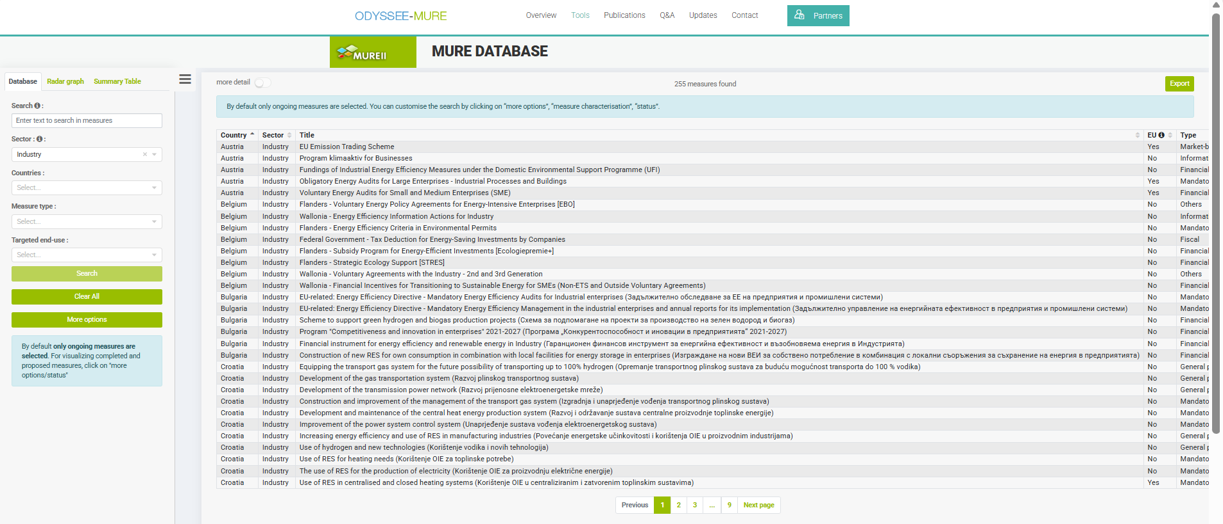
ODYSSEE-MURE project
The MURE Database on Energy Efficiency Measures

Slide 5
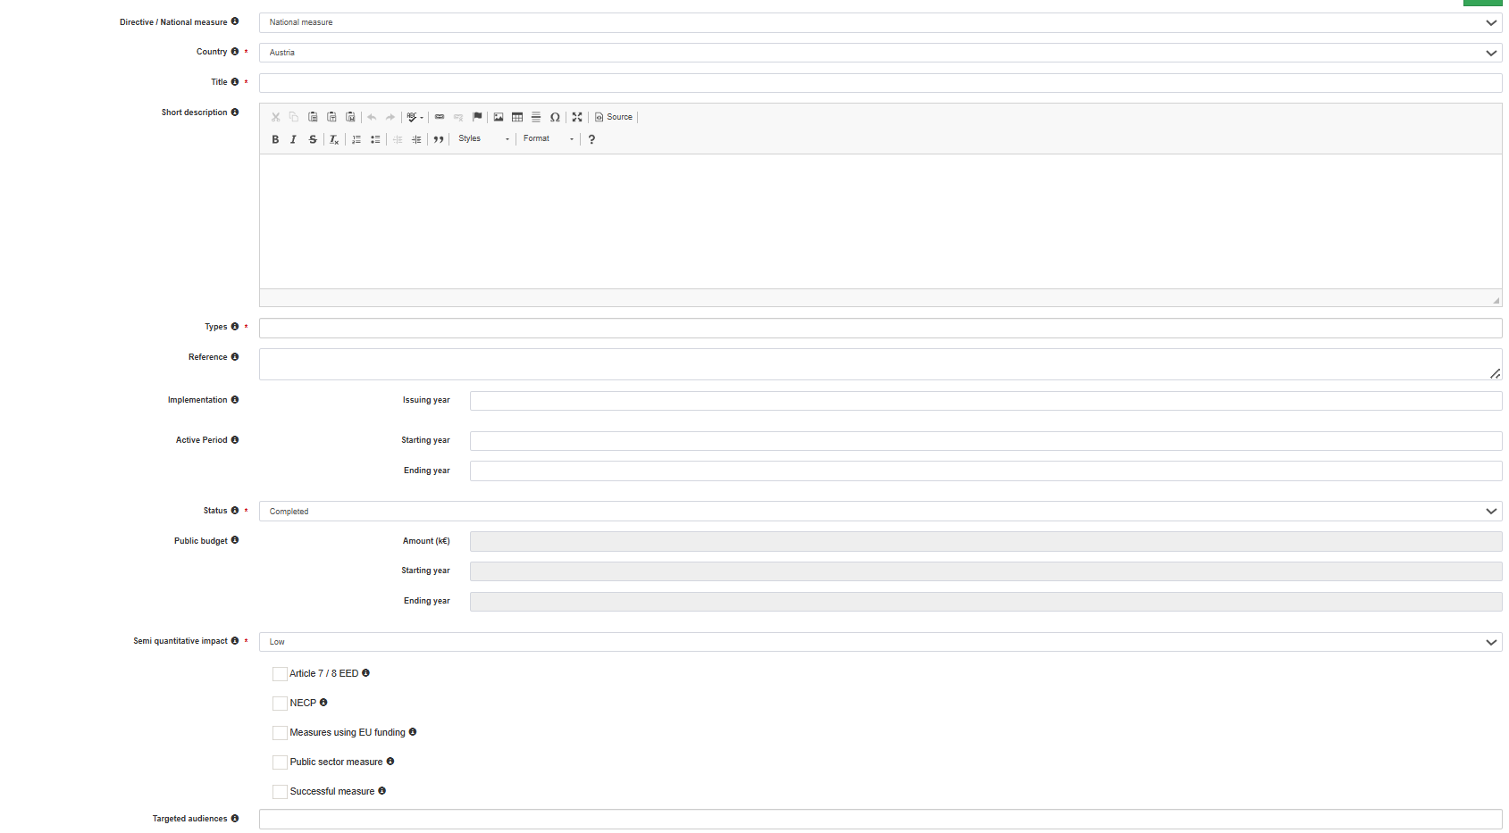
ODYSSEE-MURE project
Measures in the MURE database

Slide 6
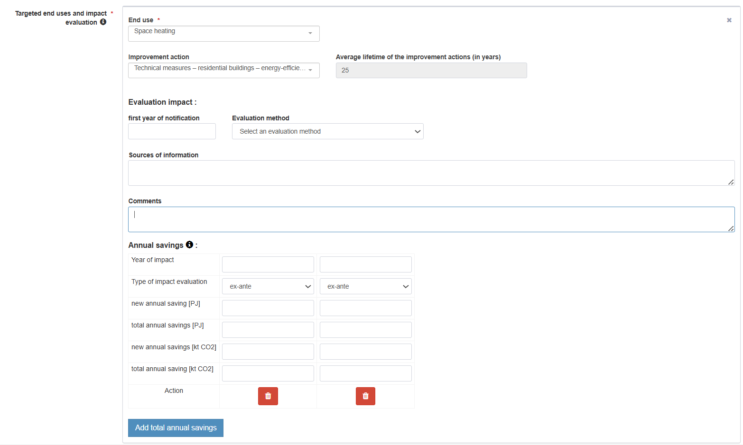
ODYSSEE-MURE project
Savings in the MURE database

Slide 7
Support for Progress Reports
MURE
Support from the ODYSSEE-MURE project
Measure impact quantifications
Support in quantifying measures (e.g. EnC)
Learning from other countries
ODYSSEE
Statistical analysis of progress in energy efficiency
Impact of different factors (beyond policy) on the evolution of energy demand
Calculation of top-down savings
Full sectoral coverage
Tools
Policy Assessment Tool
Decomposition Tool
Energy Efficiency Scoreboard
Energy Savings Tool
Multiple Benefits Analysis
Trainings
Trainings on Policy Evaluation & Analysis Tools
Trainings on Indicators & Analysis Tools
Experience exchange through (Physical) Seminars & Webinars

Slide 8
Thank you for your attention!
  —
Contact
  —
    Wolfgang Eichhammer
    Fraunhofer ISI / IEECP / Utrecht University
    Wolfgang.eichhammer@isi.fraunhofer.de
      Fraunhofer-Institut für System- und Innovationsforschung ISI
      Breslauer Straße 48
      76139 Karlsruhe
      www.isi.fraunhofer.de

