Slide 1

Energy Efficiency
JOINT ODYSSEE-MURE AND ENERGY COMMUNITY
ENERGY EFFICIENCY COORDINATION GROUP MEETING
Presentation of the Republic of Moldova
Energy Efficiency Directorate| Ministry of Energy
Chișinău | 5 November 2025

Slide 2

STATE OF PLAY
Energy Efficiency
Legal framework developed and approved in 2025,
according to Law 139/2018 on energy efficiency and Law 282/2023 on energy performance of buildings
GD No. 144/2025 of the Concept of the National Energy Efficiency Information System "NISEE“
GD No. 436/2025 National Plan for increasing the number of buildings with nearly zero energy consumption (NZEB)
GD No. 595/2025 National Long-term strategy for the renovation of the national building stock
NCM M.01.01:2025 Minimum requirements for the energy performance of buildings
NCM M.01.02:2025 Methodology for calculation of Energy Performance of Buildings
Notes:
Article 28.

Slide 3
LOOKING AHEAD
Energy Efficiency
2025
2026
Approval of GD on Regulation on the inspection of heating systems
Approval of GD on Regulation on the inspection of ventilation and air-conditioning systems
Tender for “Energy Efficiency of Buildings” Information SubSystem (SIEEC) – part of National Informational System in the Energy Efficiency (SINEE)
Approval of Concept for the Energy Services Market Development Program
Approval of the Law transposing the Directive (EU) 2023/1791 on the energy effciency
Approval of the Law transposing the Directive (EU) 2024/1275 on the energy performance of buildings
Working on the implementation of the Super-Esco Mechanism
Developing the “Energy Efficiency of Buildings” Information SubSystem (SIEEC)
Implementing Energy Performance Certification (EPC)
Training of the Energy Evaluators
Notes:
Article 28.

Slide 4
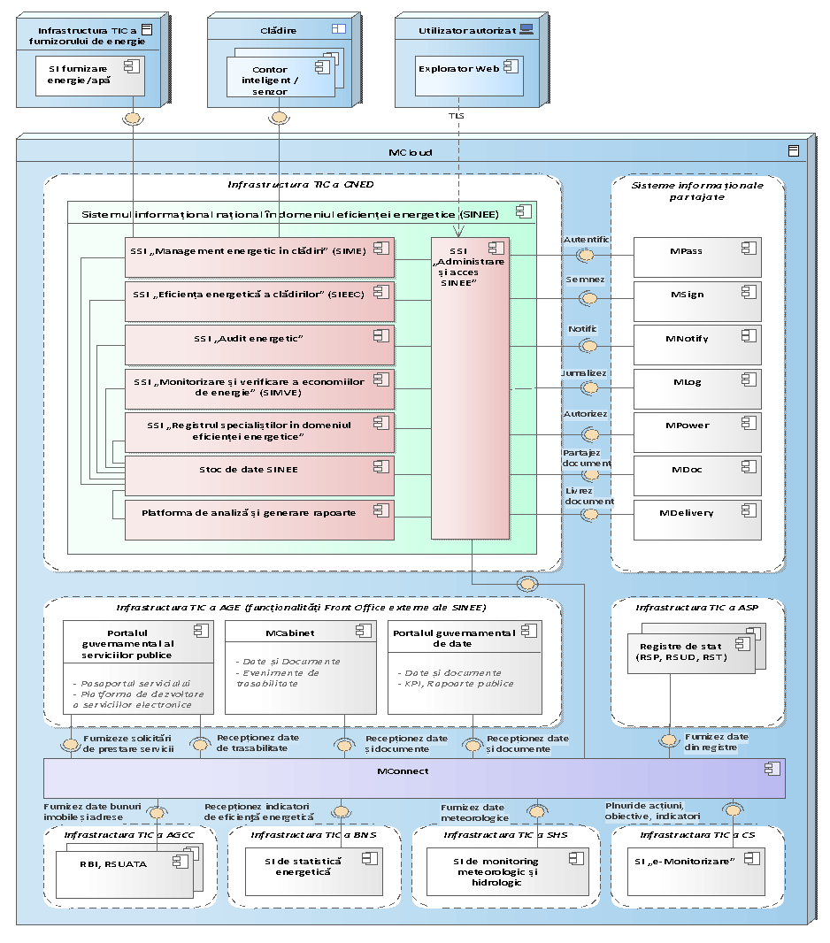
LOOKING AHEAD
Energy Efficiency
Components/subsystems of National Informational System in the Energy Efficiency
1. information subsystem "Energy management in buildings" (SIME);
2. information subsystem "Energy efficiency of buildings" (SIEEC);
3. "Energy Audit" information subsystem (SIAE);
4. information subsystem "Monitoring and verification of energy savings" (SIMVE);
5. informational subsystem "Register of specialists in the field of energy efficiency" (SIRSEE);
6. analysis and report generation platform (PAGR);
7. information subsystem "Administration and access SINEE".
Notes:
Article 28.

Slide 5






STATE OF PLAY
Energy Efficiency
Major projects for improving energy efficiency
Name | Status | Activities | Budget | Implementation period
Moldova Energy Efficiency Project (MEEP) | Ongoing | 10 Health institution and hospital buildings | Total: 76.905 mln. EUR EU grant - 15.5 mln. EUR EIB loan – 30 mln. EUR EBRD loan - 30 mln. EUR MD Government - 1.405 mln. EUR (will be extended by + 10 mln EUR due to residential component) | 2022-2027
Sustainable Transition to Energy Efficiency in Moldova (STEEM) | Ongoing | Renovation of public buildings with focus on energy efficiency - 46 public social buildings; Installation of Individual Heating Points in public buildings connected to SACET, around 280 IHP; Technical assistance; Emergency response. | Total: 54.5 mln. USD IBRD/WB loan - 50 mln. USD M-GROW grant - 4.5 mln. USD | 2024-2029
Energy Efficiency in Public Buildings in Moldova (INSPIREE) | Ongoing | Renovation of 30 public buildings with focus on energy efficiency (16 higher education buildings and 14 district hospitals) ; Technical assistance. | Total: 73.0 mln. EUR AFD loan – 30 mln. EUR KfW grant – 38.7 mln. EUR Contribution of the Republic of Moldova - 4.3 mln. EUR | 2025-2030
Notes:
Article 10. /Article 29.

Slide 6
STATE OF PLAY
Energy Efficiency
NEW major project for improving energy efficiency
Recent steps undertaken
PEEB (Program for Energy Efficiency in Public Buildings)
The Ministry of Energy:
After completing the Pre-Feasibility Study for the PEEB Project, the project Draft was examinated at the meetings of the Council for the Coordination of Sustainable Development and, subsequently, the Interministerial Committee for Strategic Planning in October, and was succesefully approved.
Following the meeting of July 22, 2025, regarding the investment projects under the Reform and Growth Mechanism for the Republic of Moldova, which are to be financed through the Neighborhood Investment Platform in Lot II, the Project "PEEB (Program for Energy Efficiency in Public Buildings)" was presented and is included in the List of Priority Projects in order to advance the technical and economic preparation and present it in terms of maturity evolution.
Total budget estimated – 103.4 mln EUR (by AFD and other co-financiers)
Notes:
Article 28.

Slide 7
STATE OF PLAY
Energy Efficiency
NEW pilot project for improving energy efficiency
Next step
„Sustainable Transition through Energy Efficiency for Moldova” (STEEM 2)
The Ministry of Energy and NCSE:
Will identify 10 buildings of the Central Public Administration Authorities (CPAs) that demonstrate the highest real potential for energy savings.
In collaboration with the World Bank, a concept note is being developed for the implementation of the second project, “Sustainable Transition through Energy Efficiency for Moldova” (STEEM 2). The upcoming project will support the establishment and operationalization of a Revolving Energy Efficiency Fund (EERF), designed to recover investments through the energy savings achieved by beneficiaries. By initially focusing on the buildings of Central Public Administration Authorities (CPAs), the initiative will lay the foundation for a sustainable system to improve energy efficiency in public buildings nationwide.
Notes:
Article 28.

Slide 8

Thank you for your attention!

